Slide 1



Overview of Goals and Approaches to Radiocarbon Dating
Andrew Parnell
January 2022

Slide 2
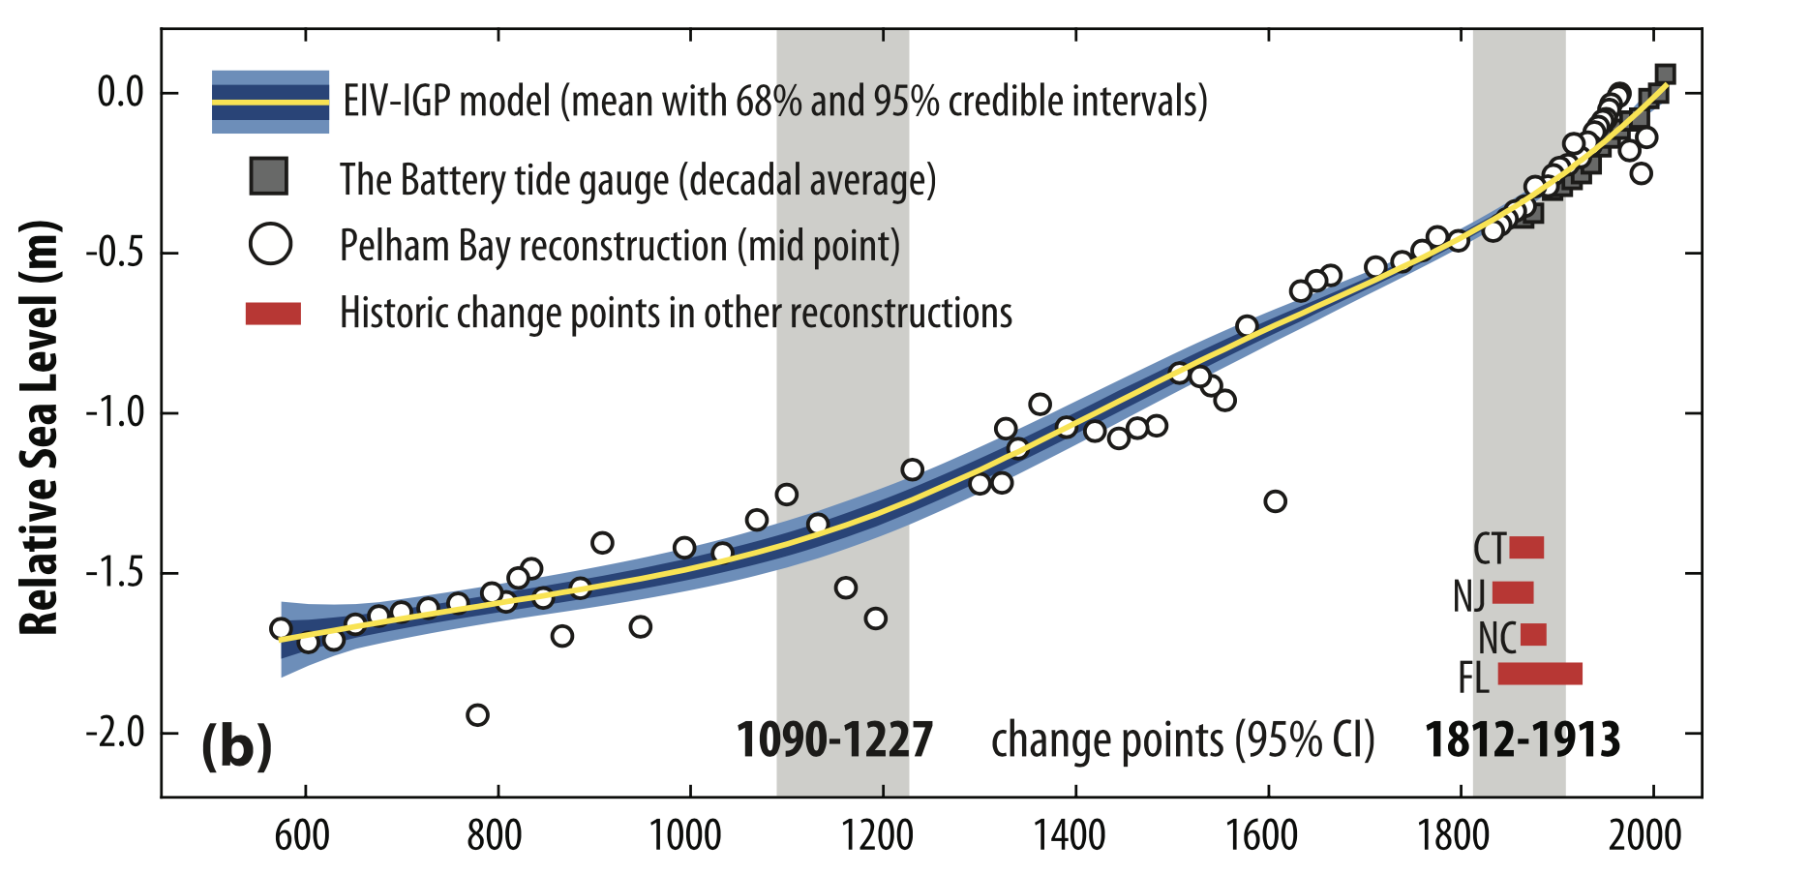
The main goal
Kemp et al (2017)

Slide 3
Steps along the way
Obtain a data set of sea level markers and dates for a subset of the markers from a core (talks 2-9)
Create an age-depth model which enables you to date all the sea level markers (this talk and 10-11)
Use a special regression model to estimate coastal change whilst taking account of the uncertainties from the age depth model (talk 12)
Creates estimates of rates/accelerations and other quantities of interest with uncertainty

Slide 4
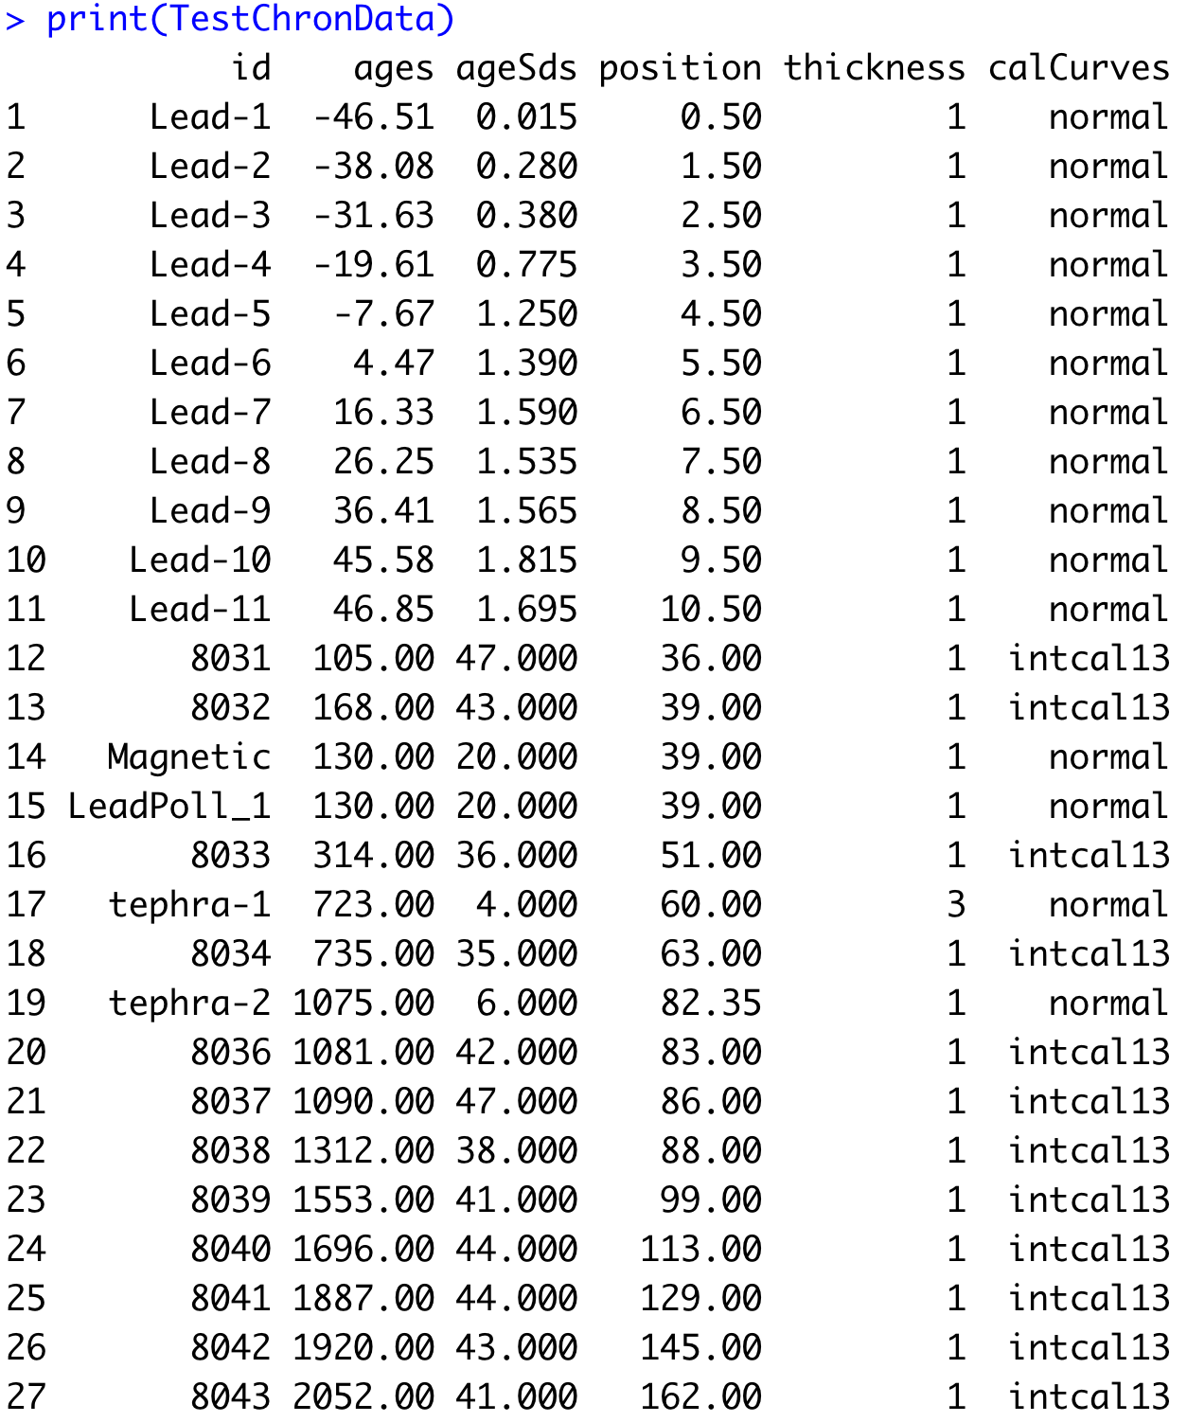
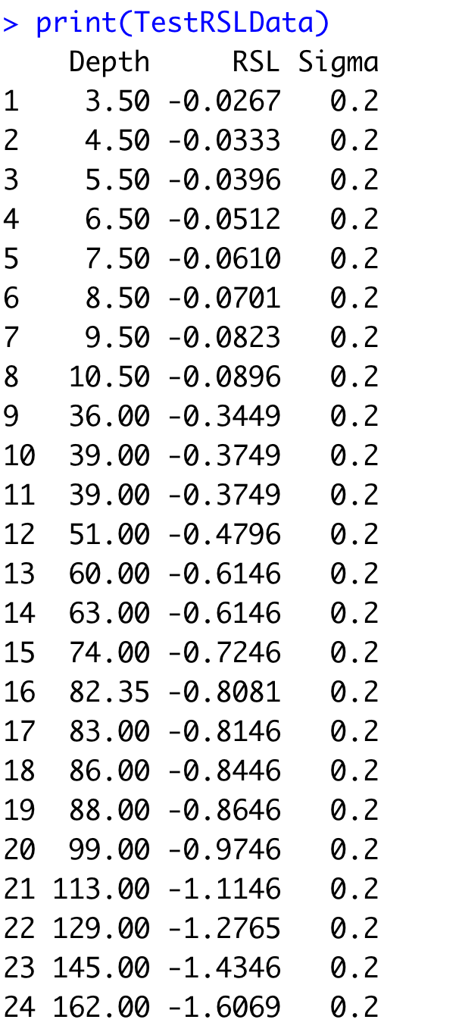
The two components as data (Bchron example)

Slide 5
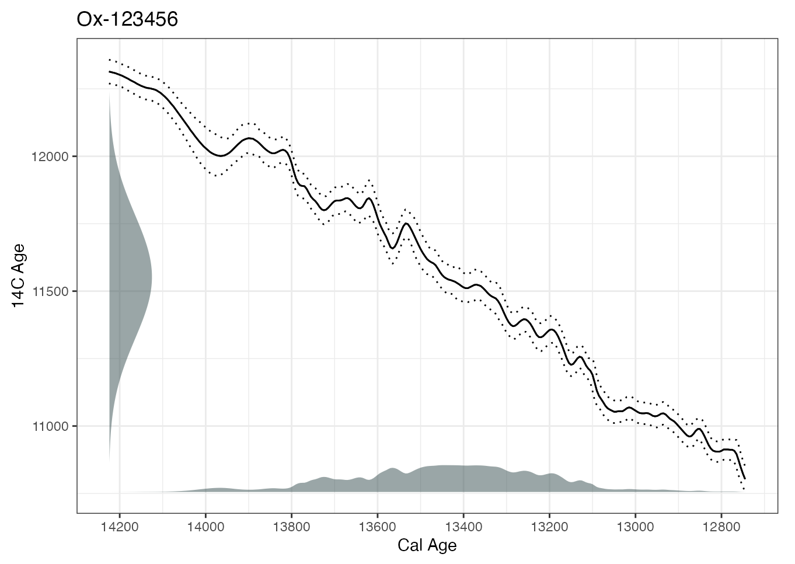
Radiocarbon dating and calibration
Dates in radiocarbon years are assumed normally distributed, once calibrated into calendar years they are very far from normally distributed

Slide 6
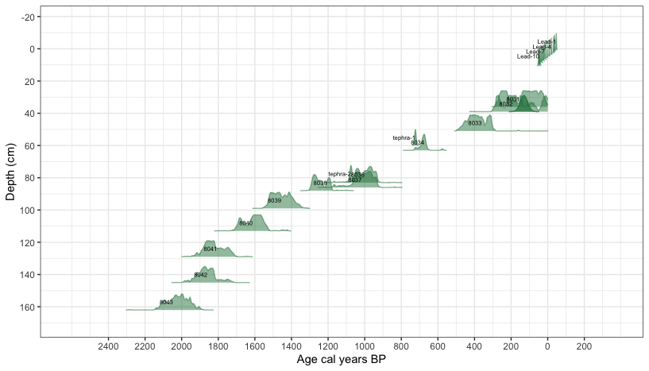
Age depth modelling

Slide 7
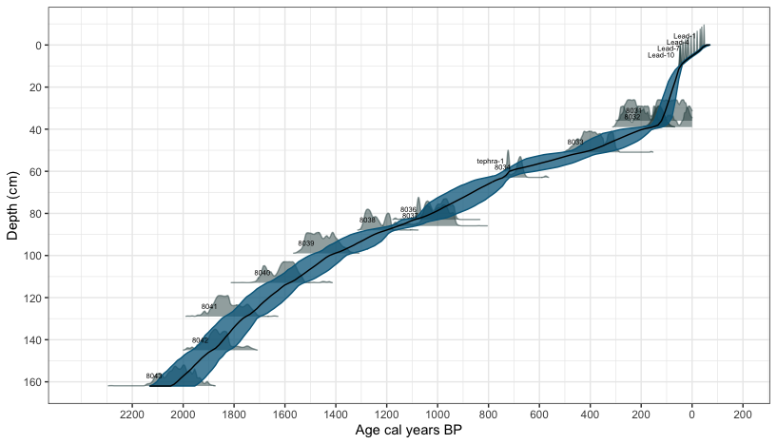
Age depth model output

Slide 8
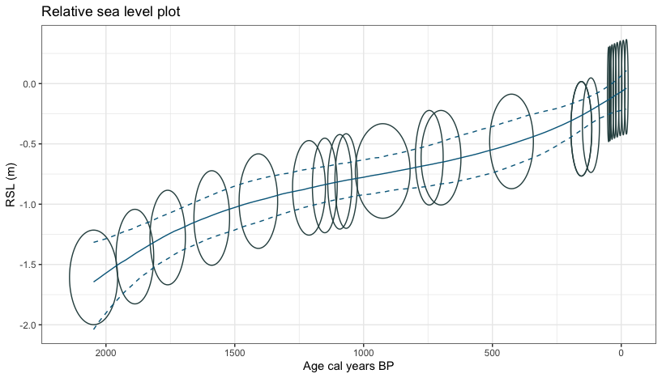
Propagating the uncertainty into the regression model

Slide 9
Software and follow-up
See the later talks for details on:
How to choose and date levels in a core
The background of age-depth models using other software (Bacon)
How to fit special regression models to account for uncertainty in the sea level markers and the age depth model
Now time for a quick demo on Bchron…

